Slide 1
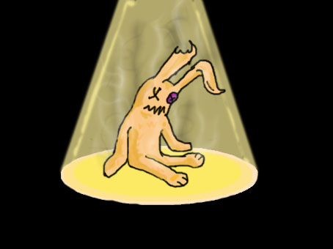
The Garden Crusade
Studio 666 presents:

Slide 2

Inleiding
GDD (Michiel)
Art Style (Anthony)
Planning (Fahrettin)
UX (Sven)
Level Design (Roos)
Code (Fahrettin)
Opleveren/Doel (Michiel)

Slide 3
GDD (Michiel)
Introstory
Uitleg Gekozen Zones
Mechanics
Puzzels Uitleg
Enemies
Unieke Aspect
Scrum Meeting

Slide 4
Art Style (Anthony)
Art Style Keuze Onderbouwing
Back-Up Assets
Concept Art

Slide 5

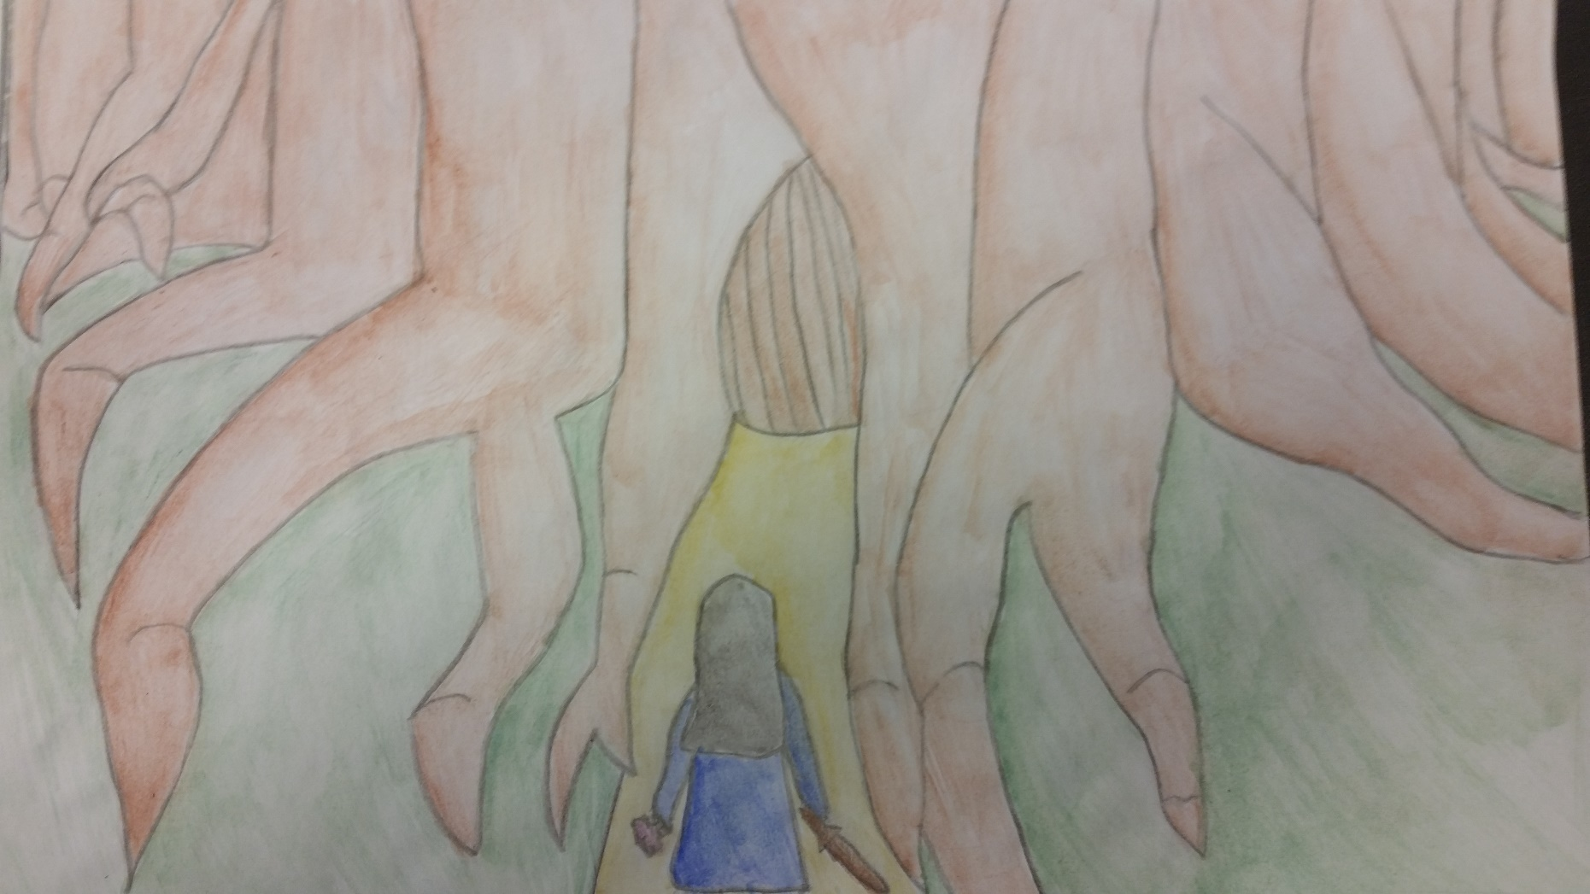
Concept Art : Environment
Boomstronk
Tutorial
Made by: Anthony

Slide 6
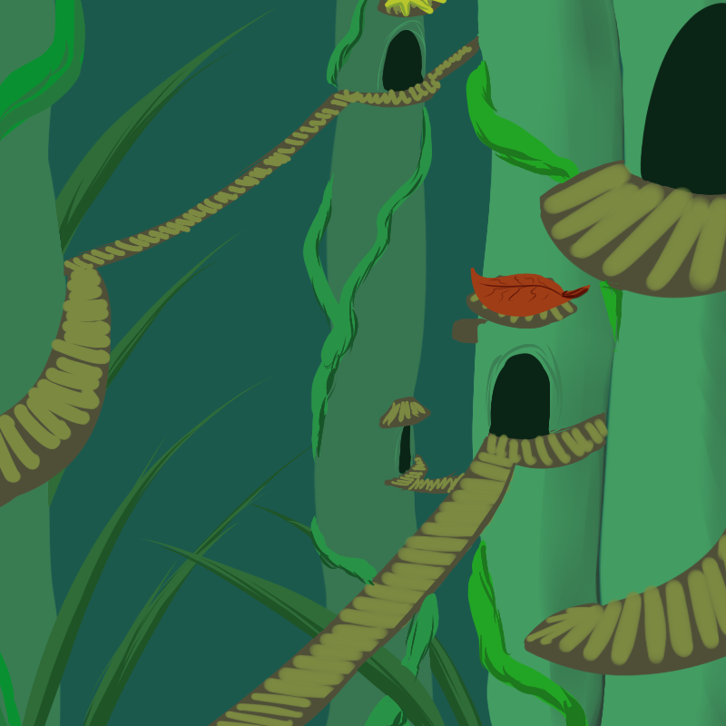
Concept Art : Environment
Ant Town
Level 1
Made by: Roos

Slide 7
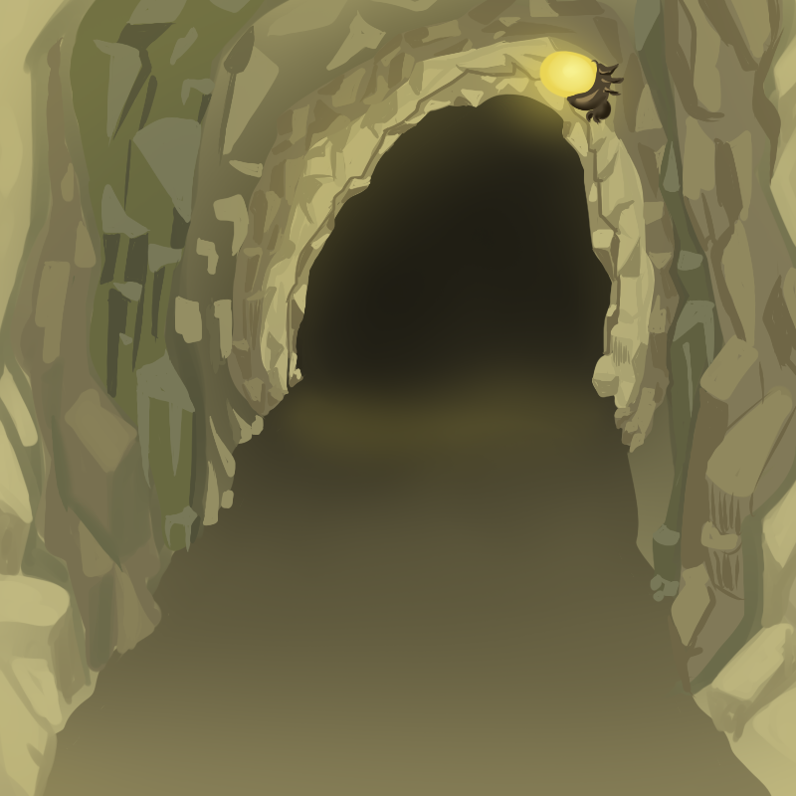
Concept Art : Environment
Cave
Level 2
Made by: Roos

Slide 8
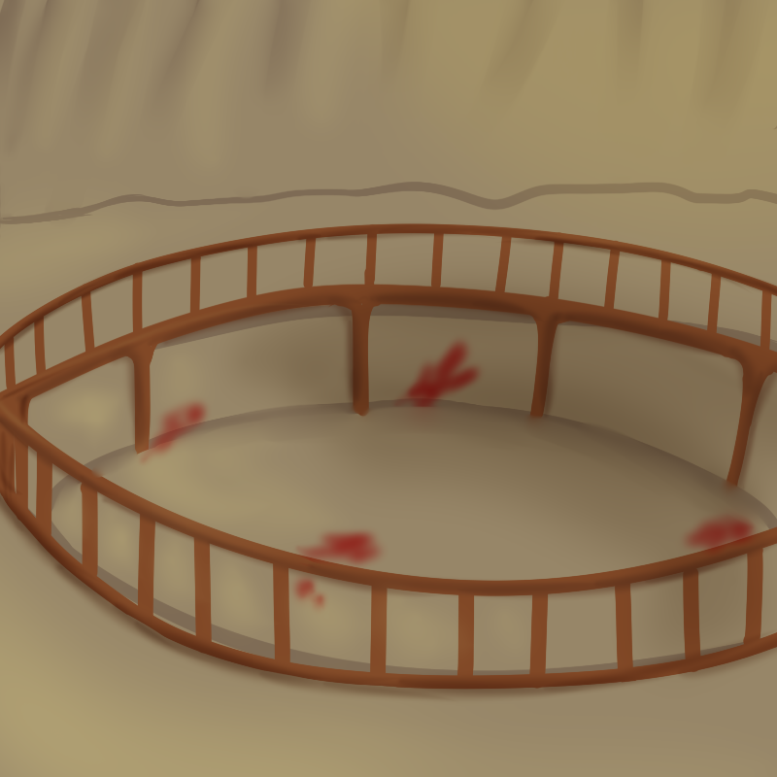
Concept Art : Environment
Fighting Pit
Level 2
Made by: Roos

Slide 9
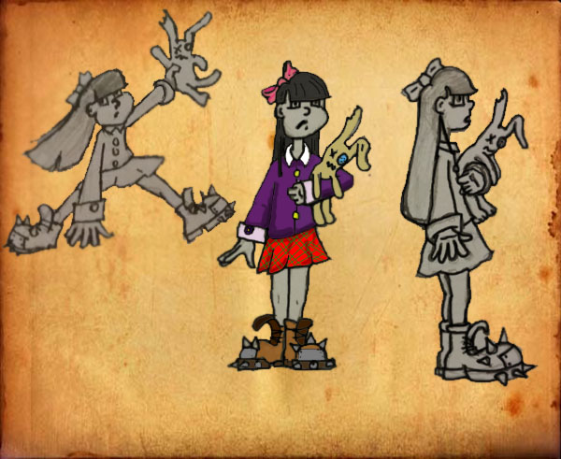
Concept Art : Character
Sarah
Made by: Michiel

Slide 10
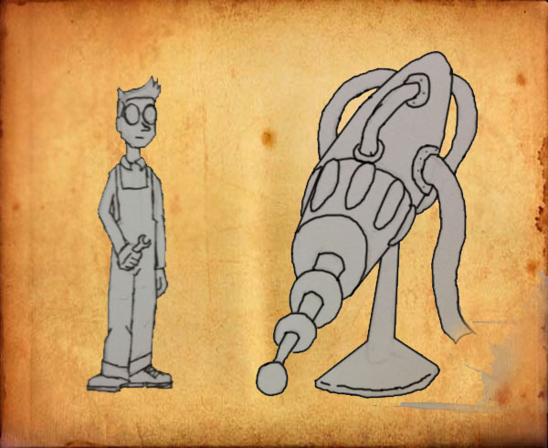
Concept Art : Character
Sarah’s Vader
Shrink Ray
Made by: Michiel

Slide 11

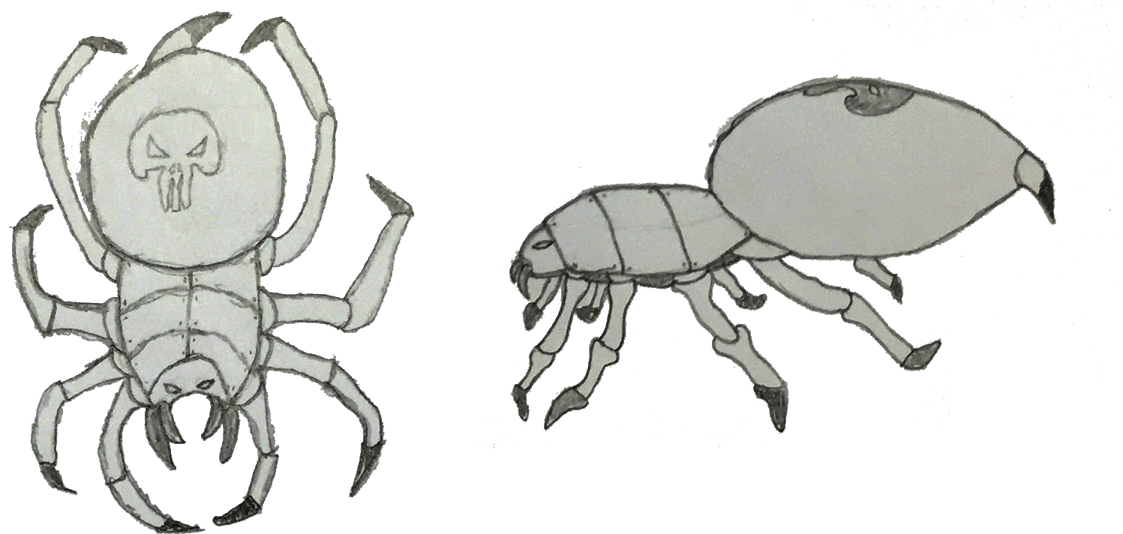
Concept Art : Enemy
Black Widow
Made by: Anthony

Slide 12
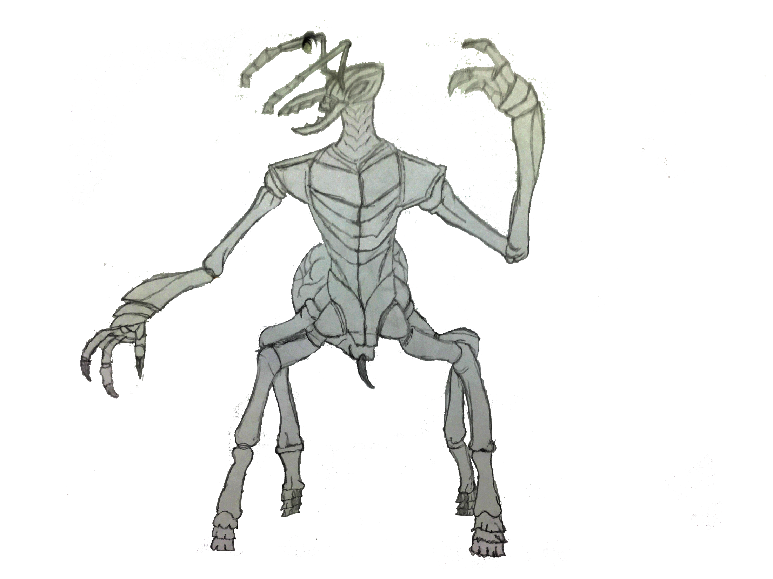
Concept Art : Ally
Ant Soldier
Made by: Anthony

Slide 13
Planning (Fahrettin)
Assetlist / Tijdsinschatting
Trello Planning / Assets
Taakverdeling
Mappenstructuur

Slide 14
Level Design (Roos)
Uitleg Zones
Puzzels In Zones

Slide 15
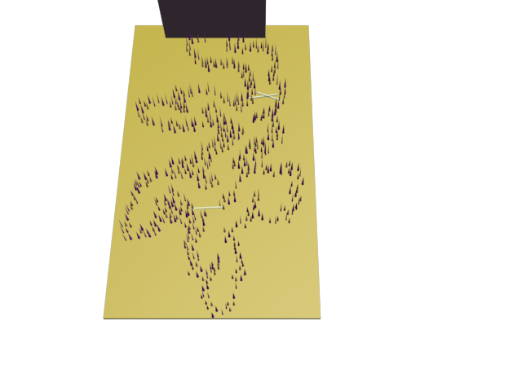
Level Design: Tutorial
Tutorial
Lady Bug Puzzel

Slide 16
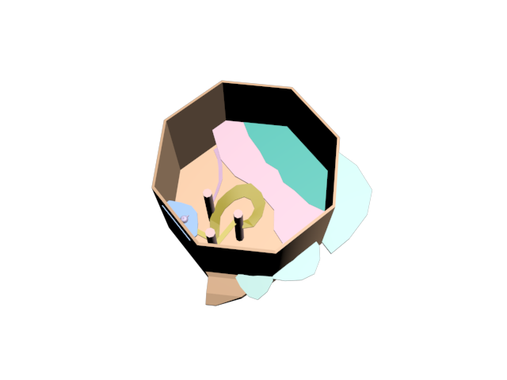
Level Design: Level 1
Boomstronk

Slide 17
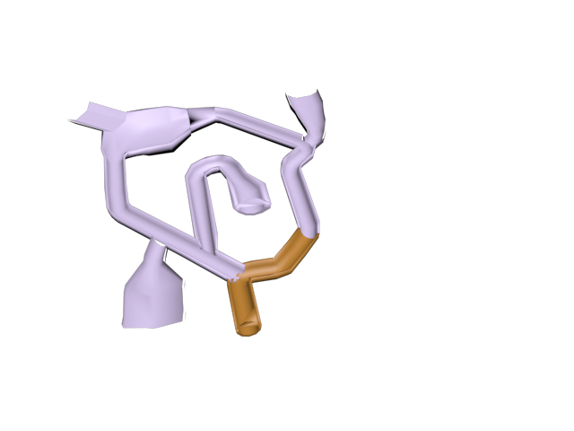
Level Design: Level 2
Underground Cave
Kleur Puzzel

Slide 18
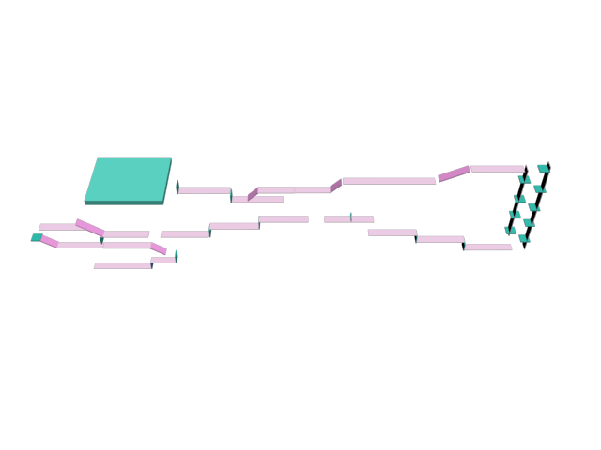
Level Design: Level 3
Schuur
Side Scroll Element

Slide 19
UX (Sven)
Uitleg Puzzels
Fun To Play
Speler Informeren
Opbouw
moeilijkheidsgraad

Slide 20
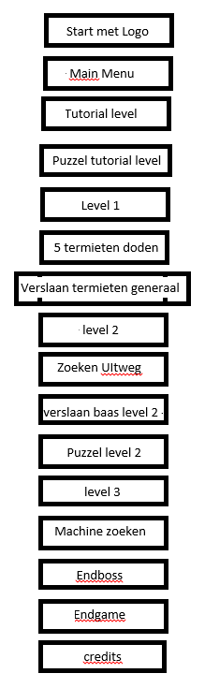
UX
Game Flow

Slide 21
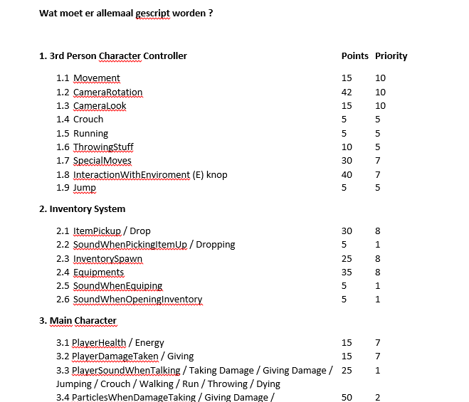
Code (Fahrettin)
Schematisch
Overzicht Van Code
Aansturen Developers
Consistentie
Uren Registratie

Slide 22
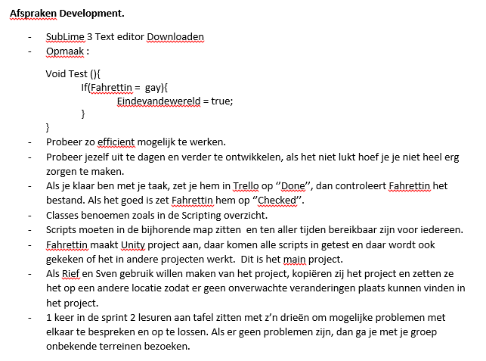
Code
Uitleg Structuur

Slide 23
Opleveren / Doel (Michiel)
Prototype Dev Fase 1
Eind Doel Dev Fase 2

Slide 24
Vragen?

